Slide 1
尼諾思科技股份有限公司 報告人：teuton
Unit test & OOC 簡報

Slide 2
大綱
概念介紹
OOC
SOLID Design Principle
Test double
Embedded TDD cycle
CGreen

Slide 3
OOC

Slide 4
Encapsulation : declare object data type
/* shape.h */
typedef struct {
char* __name;
double __x;
double __y;
}Shape;

Slide 5
Encapsulation : declare object methods
/* shape.h */
/* Shape's operations (Shape's interface)... */
void Shape_ctor(Shape * this, const char* name, double x, double y);
void Shape_moveby(Shape * this, double dx, double dy);
double Shape_gety(Shape * this);
void Shape_setx(Shape * this, double x);

Slide 6
Encapsulation : implement object constructor
/* shape.c */
#include "shape.h"
/* object constructor*/
void Shape_ctor(Shape * this, double x, double y){
this->__x = x;
this->__y = y;
}

Slide 7
Encapsulation : implement object method
/* shape.c */
void Shape_moveby(Shape* this, double dx, double dy){
this->__x += dx;
this->__y += dy;
}
void Shape_sety(Shape * this, double y){
this->__y = y;
}

Slide 8
Encapsulation : use object method
/* shape.c */
Shape test_sq;
Shape_ctor(&test_sq, "sqareTS", 2.1, 3.3);
Shape_moveby(&test_sq, 1.1, 2.3); /* __x = 3.2, __y = 5.6 */
Shape_sety(&test_sq, 2.7); /* __x = 3.2, __y = 2.7 */

Slide 9
Inheritance : declare object inheritance and its method
/* rect.h */
#include"shape.h"
typedef struct {
Shape super; /* <== inherits Shape */
double __width;
double __height;
} Rectangle;
double Rectangle_getWidth(Rectangle * this);

Slide 10
Inheritance : implement object constructor
/* rect.c */
#include"rect.h"
void Rectangle_ctor(Rectangle * this, char* name, double x, double y, double width, double height){
Shape_ctor(&this->super, name, x, y);
this->__width = width;
this->__height = height;
}

Slide 11
Inheritance : use inheritance method
/* rect.c */
Rectangle rec;
Rectangle_ctor(&rec, "rect3", 2.1, 3.2, 4.5, 5.4);
Rectangle_getHeight(&rec) /* 5.4 */
Shape_moveby(&rec.super, 1.1, 2.2); // __x = 3.2, __y = 5.4

Slide 12
Polymorphism : virtual pointer and virtual table
typedef struct {
Shape super;
double __rad;
} Circle;
typedef struct {
struct ShapeVtbl *vptr;
char* __name;
double __x;
double __y;
}Shape;
struct ShapeVtbl{
void (*xtor)(Shape * this);
double (*area)(Shape * this);
void (*draw)(Shape * this);
};
typedef struct {
Shape super;
double __width;
double __height;
} Rectangle;
static void Circle_xtor_(Shape * this);
static double Circle_area_(Shape * this);
static void Circle_draw_(Shape * this);
static void Shape_xtor_(Shape * this);
static double Shape_area_(Shape * this);
static void Shape_draw_(Shape * this);
static void Rectangle_xtor_(Shape * this);
static double Rectangle_area_(Shape * this);
static void Rectangle_draw_(Shape * this);

Slide 13
Polymorphism : declare virtual pointer
/* shape.h */
struct ShapeVtbl; /* forward declaration */
typedef struct {
struct ShapeVtbl *vptr; /* <== Shape's Virtual Pointer */
char* __name;
double __x;
double __y;
}Shape;

Slide 14
Polymorphism : declare virtual table
/* shape.h */
struct ShapeVtbl{
void (*xtor)(Shape * this);
double (*area)(Shape * this);
void (*draw)(Shape * this);
};

Slide 15
Polymorphism : declare virtual function call
/* shape.h */
static inline double Shape_area(Shape * this) {
return (*this->vptr->area)(this);
}
static inline void Shape_draw(Shape * this) {
(*this->vptr->draw)(this);
}

Slide 16
Polymorphism : declare virtual function prototypes
/* shape.c */
#include "shape.h"
/* Shape's prototypes of its virtual functions */
static void Shape_xtor_(Shape * this);
static double Shape_area_(Shape * this);
static void Shape_draw_(Shape * this);

Slide 17
Polymorphism : basic object constructor with Polymorphism
/* shape.c */
void Shape_ctor(Shape * this, double x, double y){
static struct ShapeVtbl vtbl = { /* vtbl of the Shape class */
&Shape_xtor_,
&Shape_area_,
&Shape_draw_
};
this->vptr = &vtbl; /* "hook" the vptr to the vtbl */
this->__x = x;
this->__y = y;
}

Slide 18
Polymorphism : implement basic virtual function
/* shape.c */
static double Shape_area_(Shape * this) {
assert(0); /* purely-virtual function should never be called */
return 0.0; /* to avoid compiler warnings */
}
static void Shape_draw_(Shape * this) {
assert(0); /* purely-virtual function should never be called */
}

Slide 19
Polymorphism : declare virtual function for higher objects
/* rect.c */
#include "rect.h"
/* Rectangle's prototypes of its virtual functions */
static void Rectangle_xtor_(Shape * this);
static double Rectangle_area_(Shape * this);
static void Rectangle_draw_(Shape * this);

Slide 20
Polymorphism : inheritance object constructor with Polymorphism
/* rect.c */
void Rectangle_ctor(Rectangle * this, char* name, double x, double y, double width, double height){
static struct ShapeVtbl vtbl = { /* vtbl of the Rectangle class */
&Rectangle_xtor_,
&Rectangle_area_,
&Rectangle_draw_
};
Shape_ctor(&this->super, name, x, y); /* call the superclass' ctor */
this->super.vptr = &vtbl; /* override the vptr */
this->__width = width;
this->__height = height;
}

Slide 21
Polymorphism : implement virtual function for inheritance object
/* rect.c */
double Rectangle_area_(Shape * this) {
Rectangle * this_ = (Rectangle *)this; /* explicit downcast */
return this_->__width * this_->__height;
}
void Rectangle_draw_(Shape * this) {
Rectangle * this_ = (Rectangle *)this; /* explicit downcast */
printf("Rectangle_draw_(x=%f2,y=%f2,width=%f2,height=%f2)\n", Shape_getx(this), Shape_gety(this), this_->__width, this_->__height);
}

Slide 22
SOLID Design principle

Slide 23
Single responsibility principle (bad)
double Shape_area_sum(Shape* [] shapes, int nShapes) {
/* iterate shapes and get sum here*/ /* print result here */ /* that’s two jobs! */
/* what if I change sum or print and affect each other? */
}
A class should have one and only one reason to change, meaning that a class should have only one job.

Slide 24
Single responsibility principle (fixed)
double Shape_area_sum_calculate(Shape* [] shapes, int nShapes) {
/* iterate shapes and get sum, return result here*/
}
void Shape_area_sum_print(double sums) {
/* print result here*/
}

Slide 25
Open closed principle (bad)
for (i = 0, i < nShapes, i++) {
if ( /* shapes[i] is circle*/) {
/* calculate circle area */
} else if ( /* shapes[i] is rectangle */) {
/* calculate circle area */
}
/* what if there are additional shapes? */
}
Objects or entities should be open for extension but closed for modification.

Slide 26
Open closed principle (fixed)
/* rect.c */
double Shape_area(Shape *this){
Rectangle * this_ = (Rectangle *)this;
return this_->__width * this_->__height;
}
/* circle.c */
double Shape_area(Shape *this){
Circle * this_ = (Circle *)this;
return 3.14 * this_->__radius * this_->__radius;
}
/* main.c */
for (i = 0, i < nShapes, i++) {
sum += Shape_area(shapes[i]);
}

Slide 27
Liskov substitution principle (bad)
Let q(x) be a property provable about objects of x of type T. Then q(y) should be provable for objects y of type S where S is a subtype of T.
typedef struct {
struct studentTicket;
} Child;
typedef struct {
Child super;
/* how do I use studentTicket? */
} Adult;

Slide 28
Interface segregation principle (bad)
typedef struct {
/* Shape 2D attributes here */
double (*volume)(Shape*); // 3D
} Shape; typedef struct {
Shape super;
/* why should I use volume? */
} Square;
A client should never be forced to implement an interface that it doesn’t use, or clients shouldn’t be forced to depend on methods they do not use.

Slide 29
Interface segregation principle (fixed)
typedef struct {
Shape super;
/* Shape 2D attributes here */
} 2DShape;
typedef struct {
Shape super;
double (*volume)(Shape*); // 3D
} 3DShape;
typedef struct {
2DShape super;
/* attributes for Square object here */
} Square;

Slide 30
Dependency inversion principle (bad)
dbConn = connect(MySQLConnection dbConnection);
/* What if MySQL is changed into Mongal DB? */
Entities must depend on abstractions, not on concretions. It states that the high-level module must not depend on the low-level module, but they should depend on abstractions.

Slide 31
Dependency inversion principle (fixed)
typedef struct {
Connection super;
} MySQLCConn;
typedef struct {
Connection super;
} MongalDBCConn;
dbConn = connect(Connection dbConnection);

Slide 32
Test Double

Slide 33
Tests are FIRST
Fast: tests are fast
Isolated: tests are independent of each other
Repeatable: always gives the same result
Self-verifying: return “Pass” or “Fail”
Timely: write just in time before production code

Slide 34
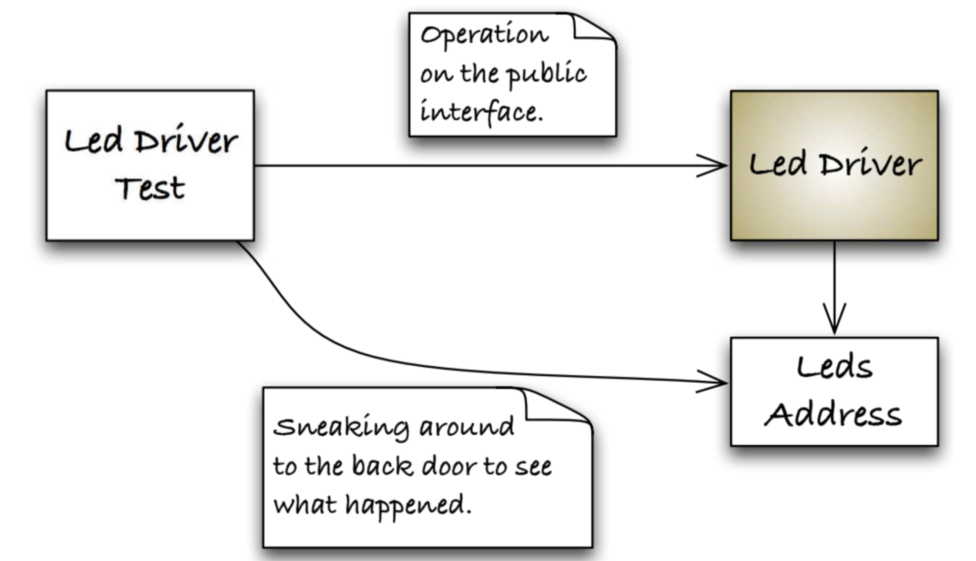
How do you test outside CUT?

Slide 35
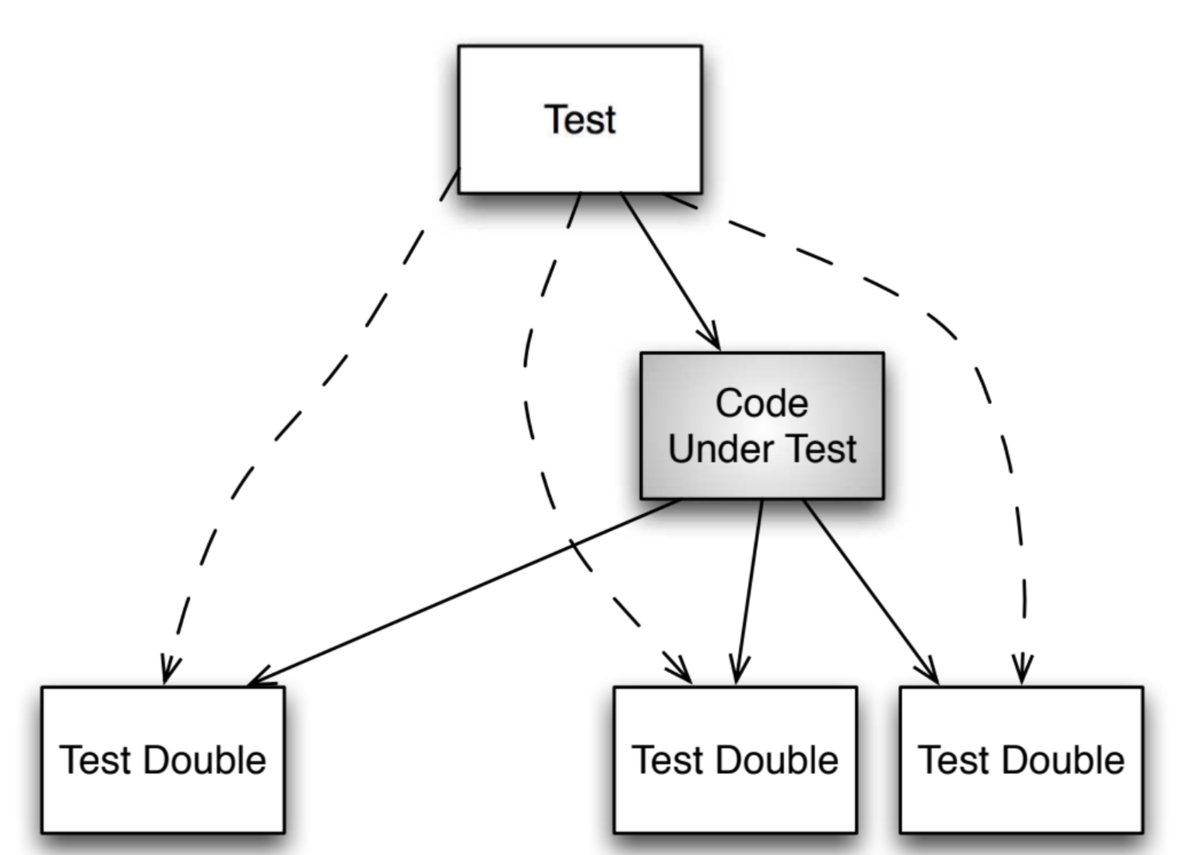
Simpliffy relationship

Slide 36
When to use test double?
Hardware independence
Inject difficult to produce input(s)
Speed up a slow collaborator
Dependency on something volatile (e.g. Time)
Dependency on something under development
Dependency on something that is difficult to configure

Slide 37
Test dummy
“I exist”
void Nothing(DummyOb* obj){}

Slide 38
Test stub
return some value
int Stub_add_up(StubOb* obj){
return 3;
}
assert_that(Stub_add_up(&stuby), is_equal_to(3));

Slide 39
Test spy
Capture parameter
int Spy_add_up(SpyOb* obj){
obj->called_add = true;
return obj->a + obj->b;
}
assert_that(Spy_add_up(&spyy), is_equal_to(3));
assert_that(spyy.called_add, is_true);

Slide 40
Mock object
Verify function called
/* determine what parameter to observe at given phase */
void mocked_callback(int x, int y) {mock(x, y);}
/* main observe function */
void Mock_add_more(MockOb* obj){
mocked_callback(obj->a, obj->b);
obj->a += 1;
obj->b += 2;
mocked_callback(obj->a, obj->b);}

Slide 41
Mock object
/* declare parameter status, in order */
expect(mocked_callback,
when(x, is_equal_to(2)),
when(y, is_equal_to(1)));
expect(mocked_callback,
when(x, is_equal_to(3)),
when(y, is_equal_to(3)));
Mock_add_more(&mocky); // call function

Slide 42
Embedded TDD Cycle

Slide 43
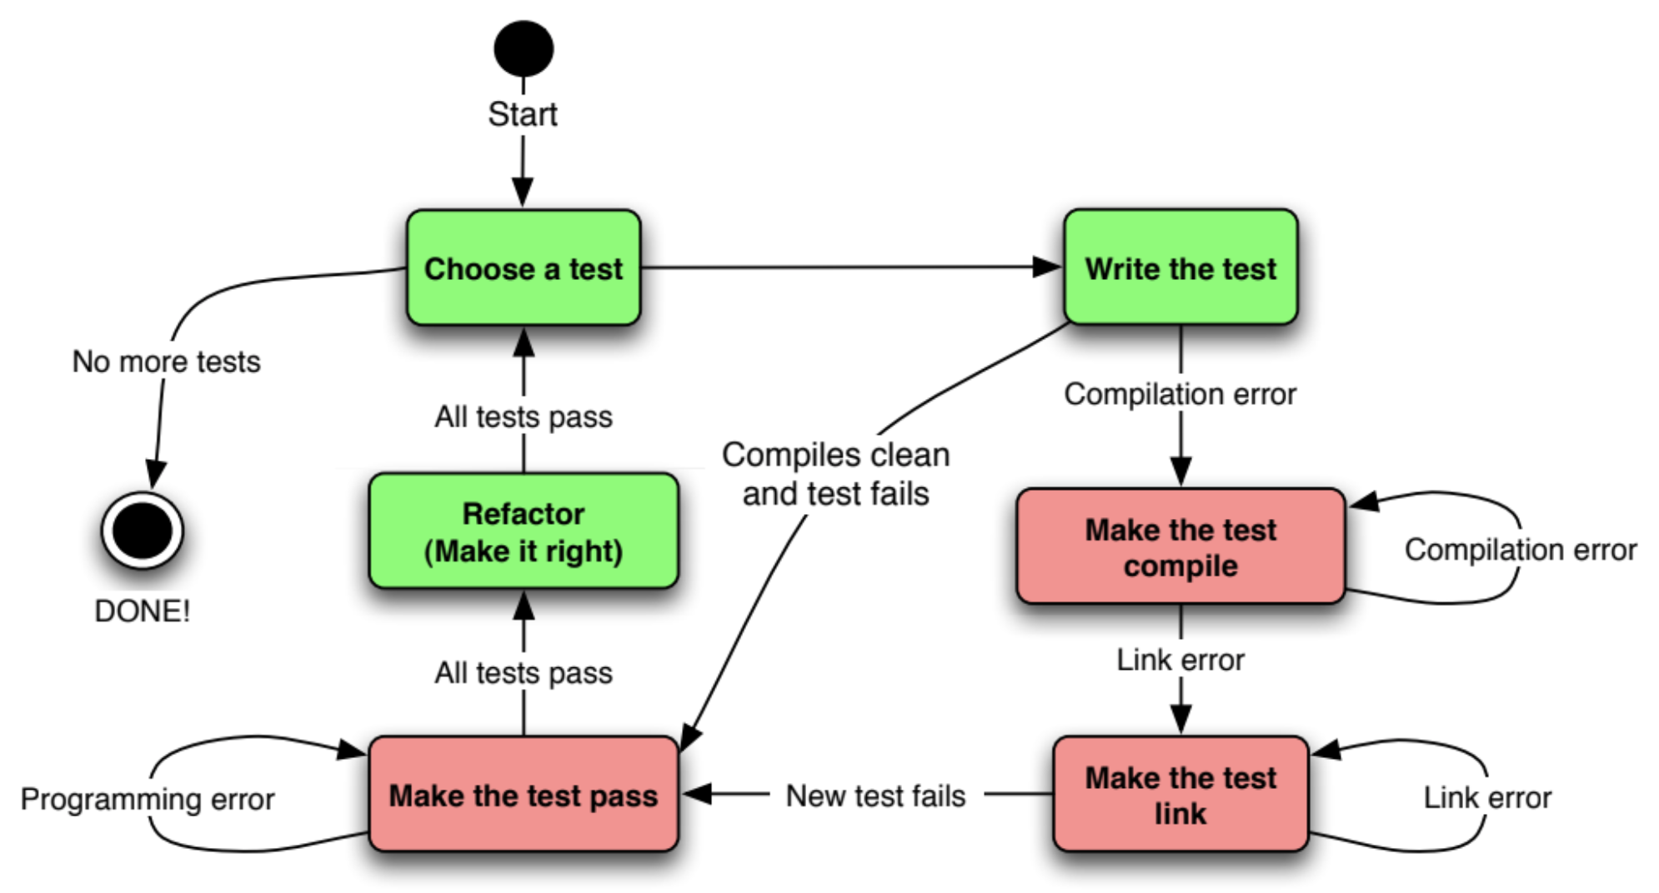
TDD cycle

Slide 44
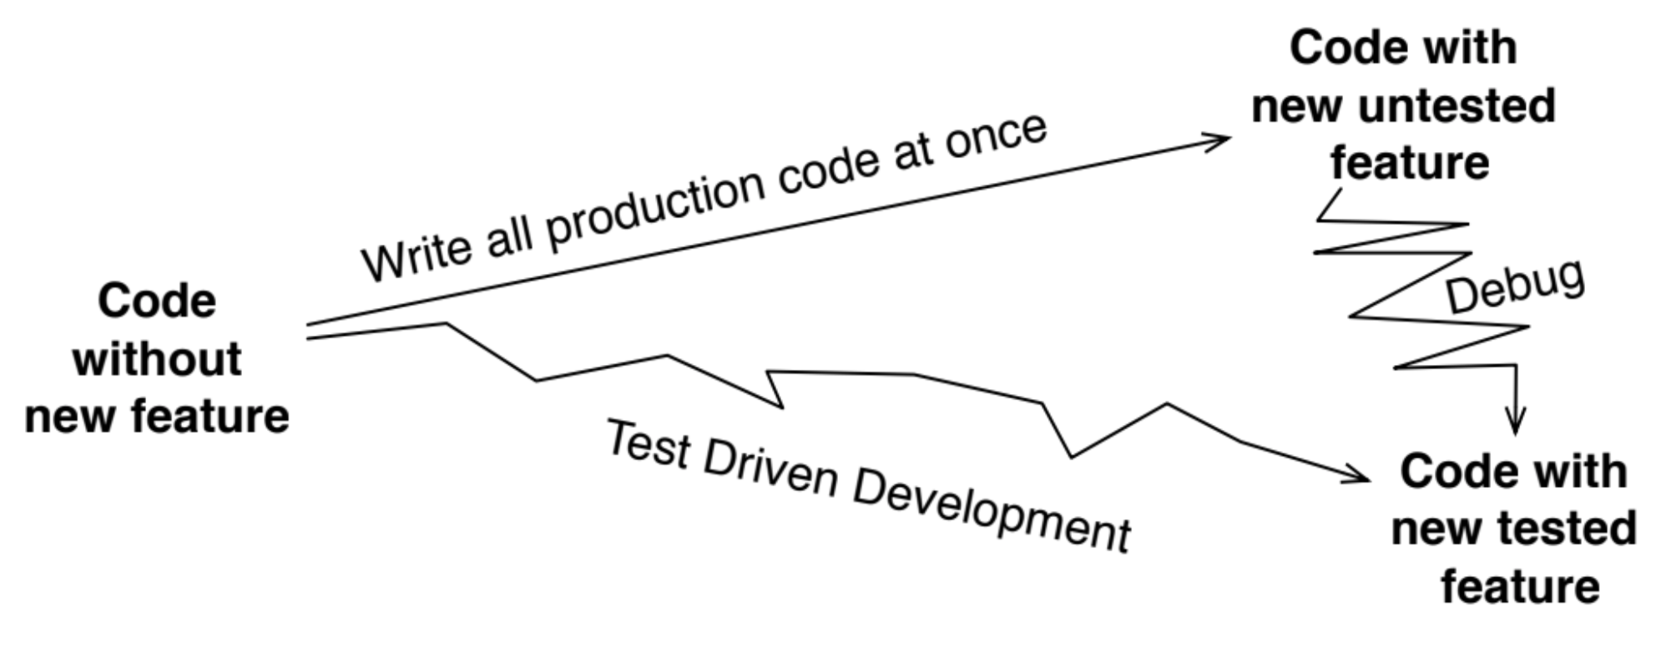
Why TDD?

Slide 45
The target hardware bottleneck
Target hardware is not ready
Target hardware is expensive/scarce
Target hardware may have bug of its own
Longer target build time
Longer target upload time
Compiler difference

Slide 46
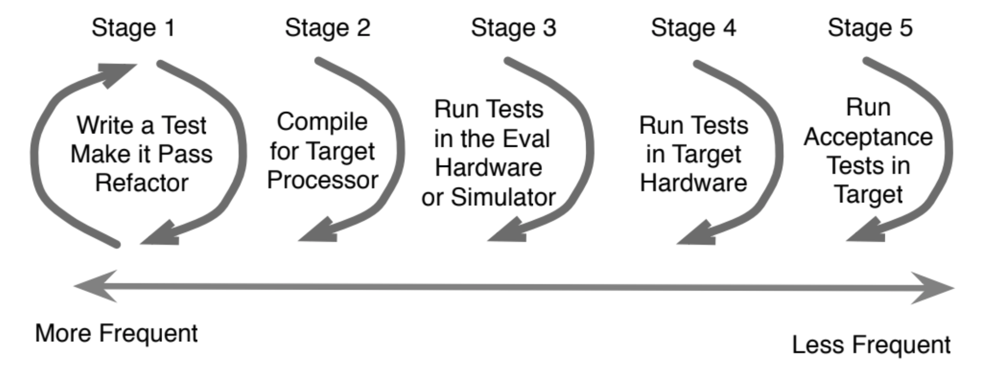
Embedded TDD Cycle

Slide 47
CGreen 簡介

Slide 48
What is CGreen?
open source unit tester for C and C++
apt-get install cgreenl

Slide 49
CGreen Testifle part1
#include <cgreen/cgreen.h>
Describe(FirstTest);
BeforeEach(FirstTest) {}
AfterEach(FirstTest) {}
Ensure(FirstTest, addUp) {
assert_that(strlen(“hello”), is_equal_to(5));
}

Slide 50
CGreen Testifle part2
Ensure(FirstTest, dummy) {
assert_that(3, is_equal_to(3));
}
TestSuite *FirstTest_tests() {
TestSuite *suite = create_test_suite();
add_test_with_context(suite, FirstTest, addUp);
add_test_with_context(suite, FirstTest, dummy);
return suite;
}

Slide 51
CGreen main file
#include <cgreen/cgreen.h>
TestSuite *FirstTest_tests();
int main(int argc, char **argv) {
TestSuite *suite = create_test_suite();
add_suite(suite, FirstTest_tests());
if (argc > 1) {
return run_single_test(suite, argv[1], create_text_reporter());
}
return run_test_suite(suite, create_text_reporter());
}

Slide 52
How does CGreen resemble BDD?
Describe(Strlen);
BeforeEach(Strlen) {}
AfterEach(Strlen) {}
Ensure(Strlen, returns_five_for_hello) {
assert_that(strlen("Hello"), is_equal_to(5));
}
TestSuite *our_tests() {
TestSuite *suite = create_test_suite();
add_test_with_context(suite, Strlen, returns_five_for_hello);
return suite;
}

Slide 53
CGreen constraints example
is_true, is_non_null (Basic)
is_equal_to(value), is_less_than(value) (Integer)
is_equal_to_string(value), ends_with_string(value) (String)
is_equal_to_double(value), is_greater_than_double(value) (Double)
assert_that(expected, constraint)
assert_that_double(expected, constraint)

Slide 54
Thank You. 簡報完畢

